Slide 1
Casual Games: Less is More
Game Design 2 – lecture 6

Slide 2
“It seems that perfection is reached not when there is nothing left to add, but when there is nothing left to take away.”
-Antoine de Saint-Exupéry

Slide 3
Casual Games

Slide 4
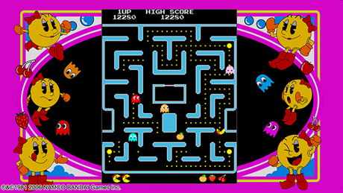
Pre-casual games

Slide 5
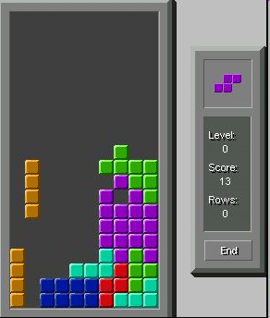

Slide 6
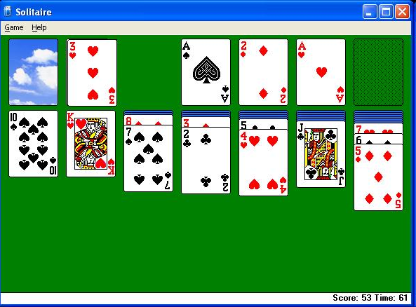
Solitaire:
Most played game ever?

Slide 7
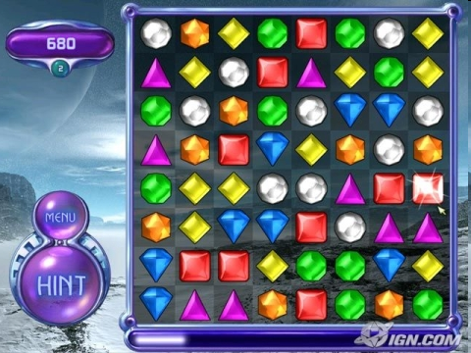
Bejeweled
Starting point of a genre?

Slide 8

4 million downloads
over first 5 months

Slide 9
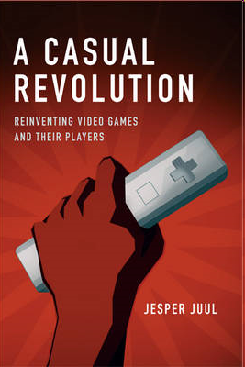

Slide 10
Stereotypical Hardcore Preferences
Fiction preference
Positive
Negative
Game knowledge
Low
High
Time investment
Low
High
Attitude toward difficulty
Dislikes
Prefers

Slide 11
Stereotypical Casual Preferences
Fiction preference
Positive
Negative
Game knowledge
Low
High
Time investment
Low
High
Attitude toward difficulty
Dislikes
Prefers

Slide 12
Elements of Casual Game Design
Fiction
Usability
Interruptibility
Difficulty and Punishment
Juiciness

Slide 13
Fiction

Slide 14
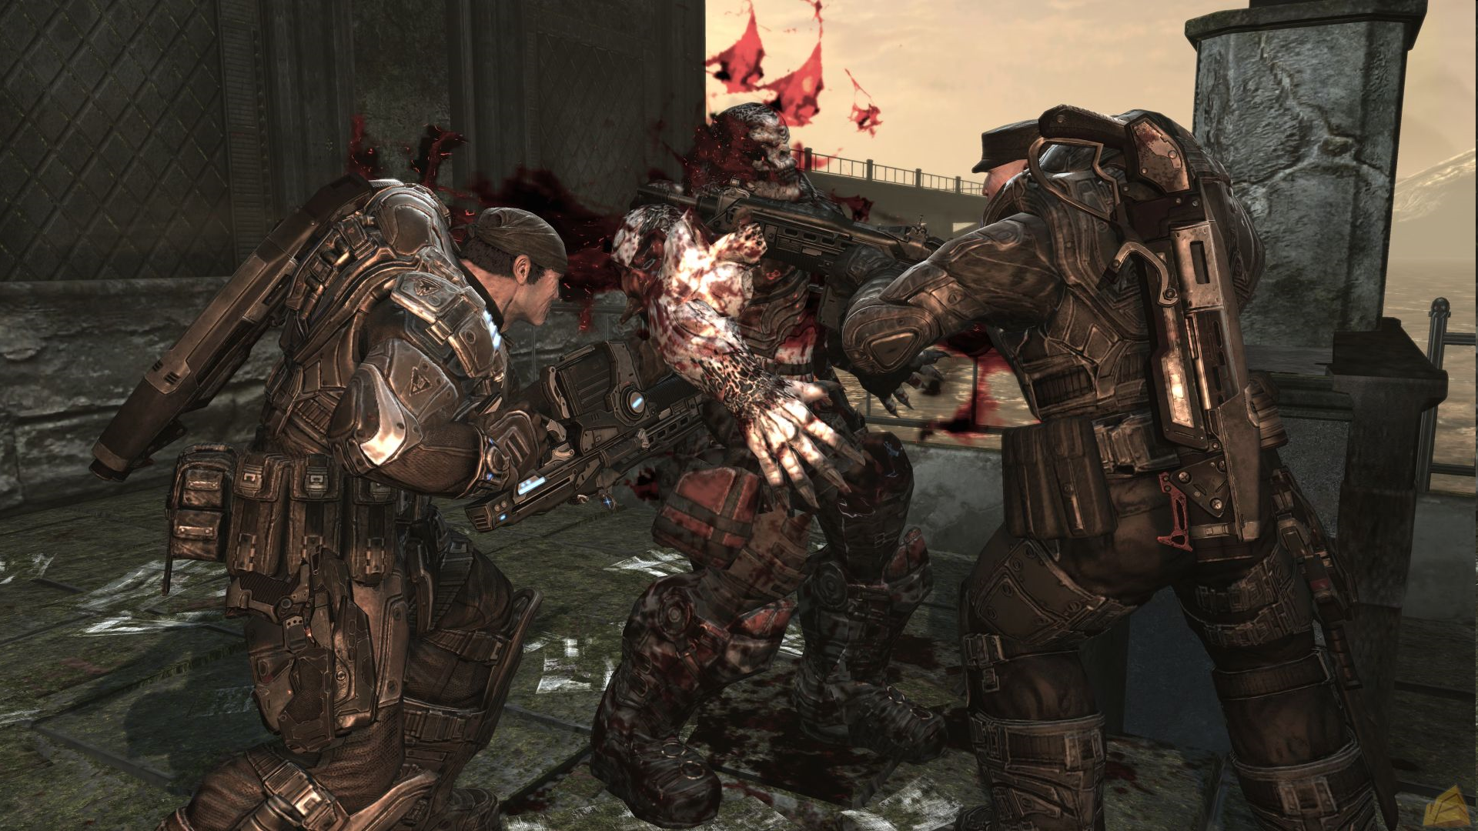
Negative fiction:
Situations you would run
away from in real-life

Slide 15
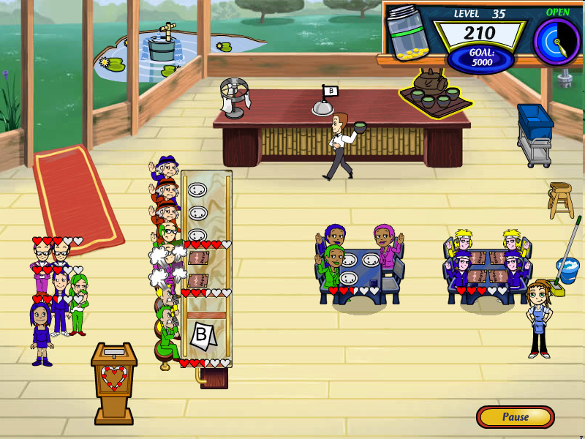
Positive fiction:
Situations you would feel
comfortable in, in real-life

Slide 16
Bejeweled
Little fiction: but positive

Slide 17
Usability

Slide 18
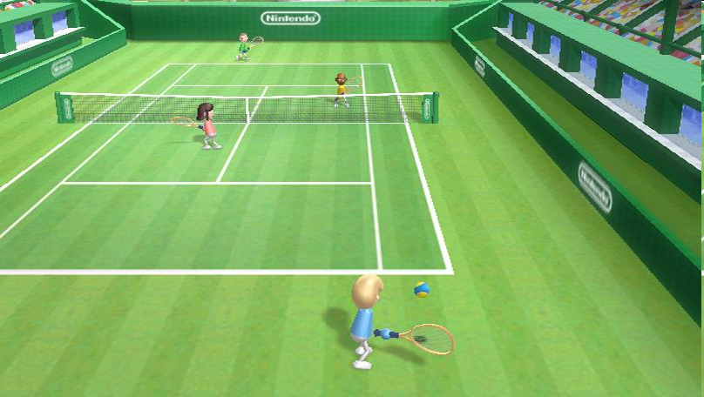
Usability
Wii Sports: Tennis

Slide 19
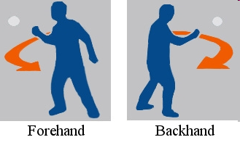
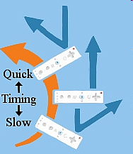

Slide 20
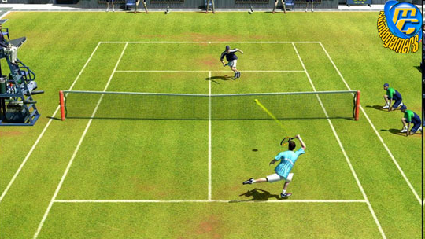
Usability
Virtua Tennis 3

Slide 21
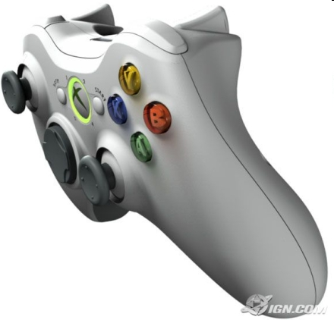
Instruct COM partner
Instruct COM partner
Instruct COM partner
Instruct COM partner
Toggle viewpoint
Lob shot
Slice shot
Move / Aim /
Aftertouch
Slice shot
Top spin shot
Move / Aim /
Aftertouch
Xbox Guide button
Move camera
Pause game

Slide 22
Interruptability

Slide 23
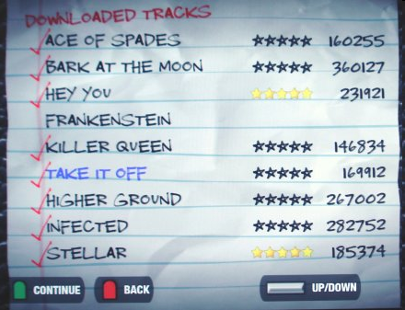
Interruptability
Guitar Hero

Slide 24
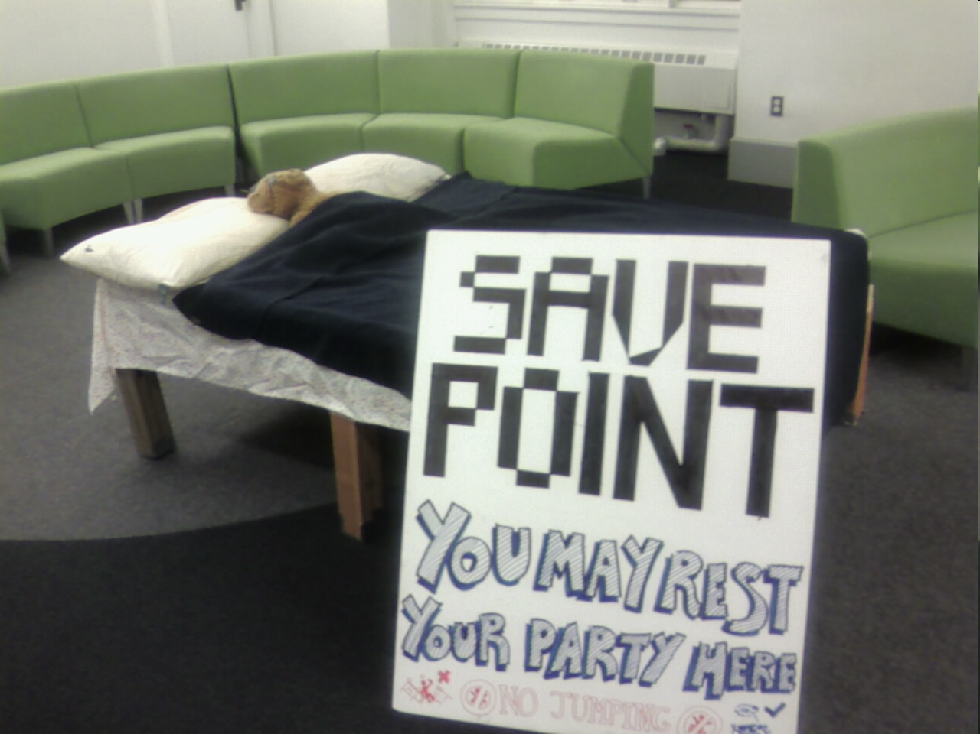

Slide 25
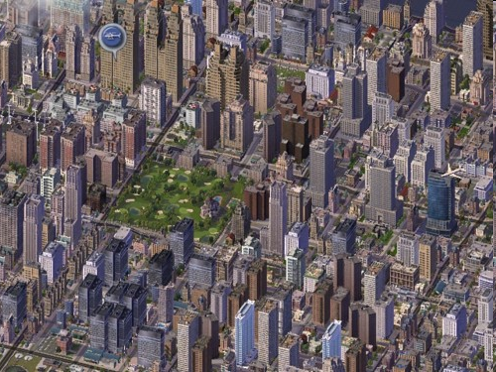
Interruptability?
Sim City

Slide 26
Difficulty and punishment

Slide 27
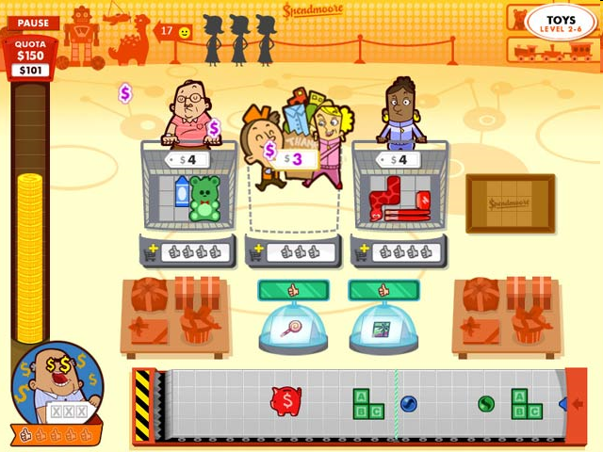
Difficulty and punishment
“No casual game has ever
failed for being too easy”

Slide 28
Shopmania
Catherine Herdlick and
Eric Zimmerman
“the problem with going too far in this
direction is that the game ends up feeling
like interactive muzak: you can play
forever and not really lose, and the
essential tension and challenge of a good
game are lost”

Slide 29
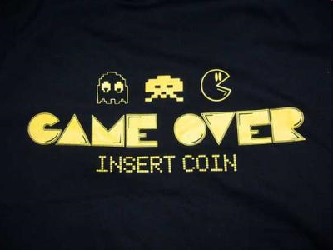

Slide 30
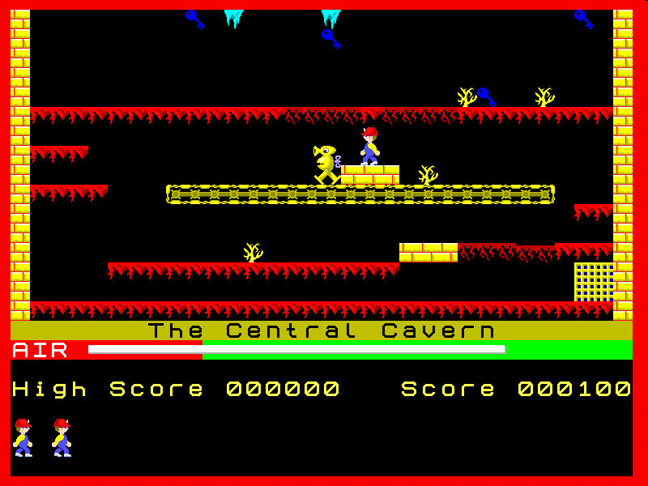
Manic Miner
What happens when you fail?

Slide 31
start over from beginning
every level exactly the same

Slide 32

Failure
How much time do you loose?

Slide 33
Bejeweled:
a new random puzzle
every time

Slide 34
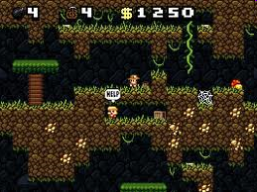
Spelunky:
Generative content

Slide 35
Juiciness

Slide 36
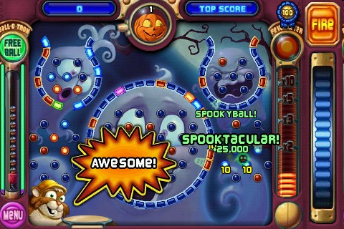
Peggle
Juiciness

Slide 37
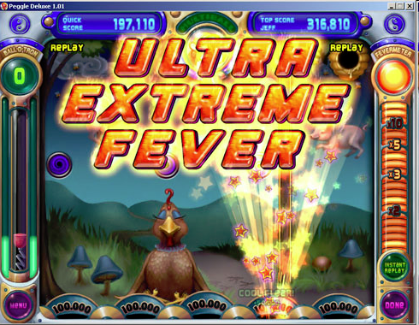
Juul
“Positive feedback”

Slide 38
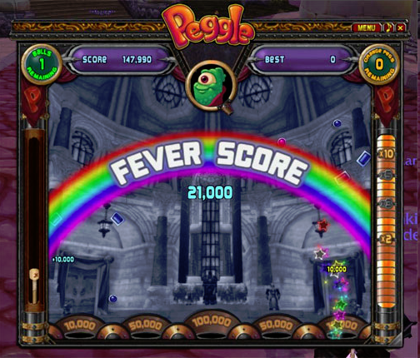
Myself:
“Amplification of user input”:
do something small and simple
get something big and awesome

Slide 39
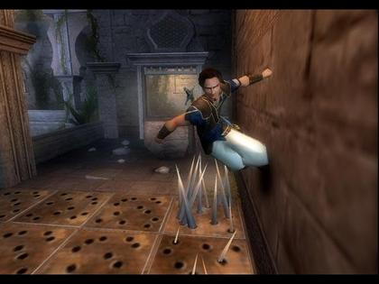
Certain games make you feel
powerful and super-human

Slide 40
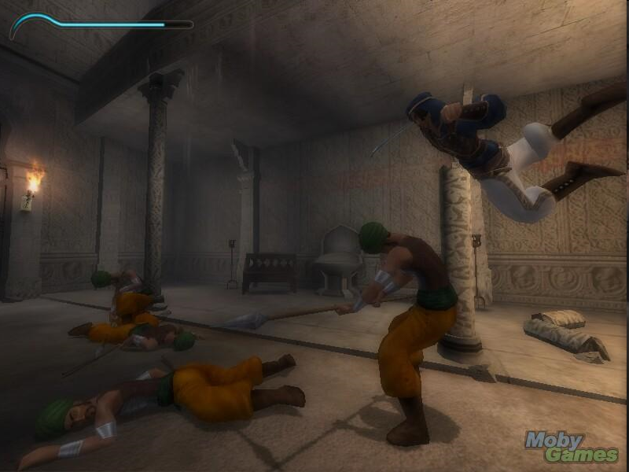
Prince of Persia makes me
feel awesome!

Slide 41
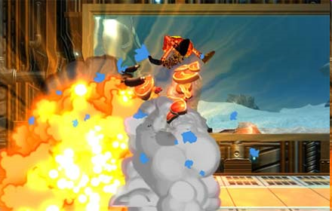
‘Splosion Man
Juiciness

Slide 42
Juiciness example
http://grapefrukt.com/f/games/juicy-breakout/

Slide 43
Casual Preferences
Fiction preference
Positive
Negative
Game knowledge
Low
High
Time investment
Low
High
Attitude toward difficulty
Dislikes
Prefers

Slide 44
Casual Preferences
Fiction preference
Positive
Negative
Game knowledge
Low
High
Time investment
Low
High
Attitude toward difficulty
Dislikes
Prefers

Slide 45
Casual Preferences
Fiction preference
Positive
Negative
Game knowledge
Low
High
Time investment
Low
High
Attitude toward difficulty
Dislikes
Prefers

Slide 46
Ex-hardcore players
Fiction preference
Positive
Negative
Game knowledge
Low
High
Time investment
Low
High
Attitude toward difficulty
Dislikes
Prefers

Slide 47
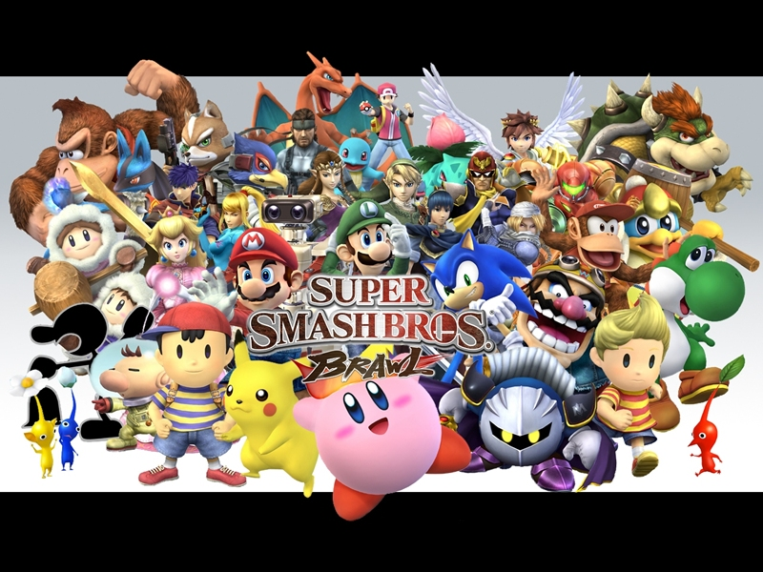
Hardcore games that allow casual play, and vice versa

Slide 48
Less is More

Slide 49
Games and Simulation
Chris Crawford:
“A simulation bears the same relationship to a game that a technical drawing bears to a painting. A game is not merely a small simulation lacking the degree of detail that a simulation possesses; a game deliberately suppresses detail to accentuate the broader message that the designer wishes to present. Where a simulation is detailed a game is stylised.”
(The Art of Computer Game Design, 1982, p. 9)

Slide 50
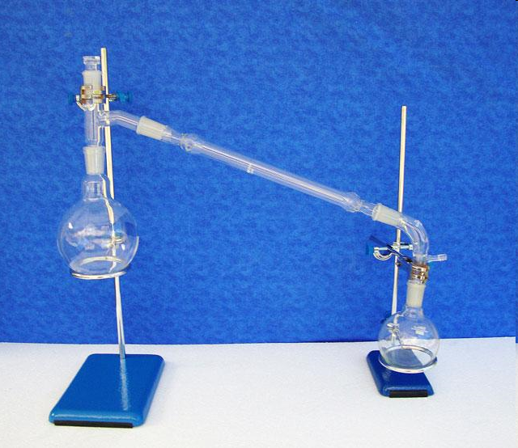
Making games is
distilling a simulation
down to its essence
Daniel Cook

Slide 51
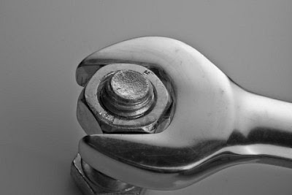
Use polish to build tight
game systems of cause
and effect.
Daniel Cook

Slide 52
Support the player in
learning to play your game

Slide 53
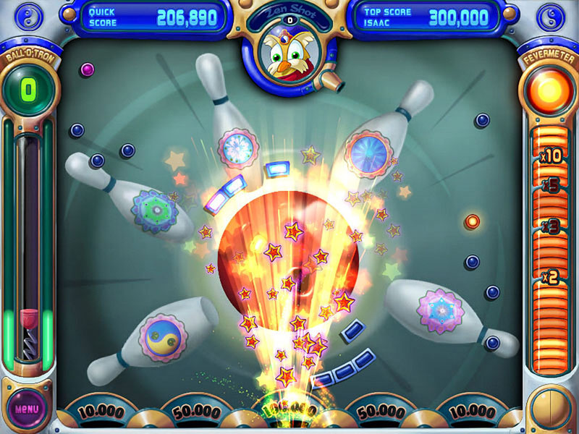
Strong feedback makes
a game tighter.

Slide 54
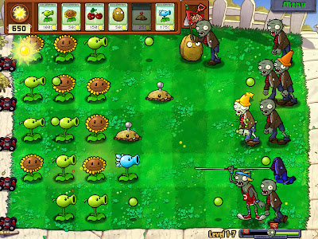

Slide 55
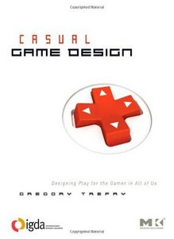

Slide 56
Gregory Trefry
Matching (Bejeweled)
Sorting (Solitaire)
Seeking (Azada)
Managing (Diner Dash)
Hitting (Wii Tennis)
Chaining (Diner Dash)
Constructing (Crayon Physics)
Bouncing, Tossing , Rolling and Stacking (Bow Man 2)
Socializing (Rock Band)

Slide 57
Matching: Bejeweled

Slide 58
Matching: Bejeweled
* Swap adjacent gems to align sets of three
* Only swap to make a combo
* Combo and large sets score extra
* Fill meter for a bonus

Slide 59
Matching: Bejeweled
Normal mode versus timed mode

Slide 60
Matching: Bejeweled
* You cannot make a wrong move * All moves score points (continuous positive feedback)
* Quick to master * Endless random puzzle

Slide 61
Matching: Bejeweled
Gregory Trefry:
“Remove one element of Bejeweled and it would
simply collapse and no longer be a game”

Slide 62
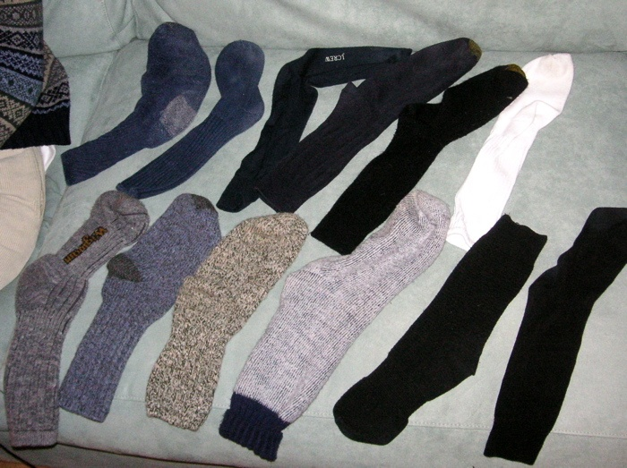
Matching: Bejeweled
Matching taps
into a human instinct?

Slide 63
Sorting, too?

Slide 64
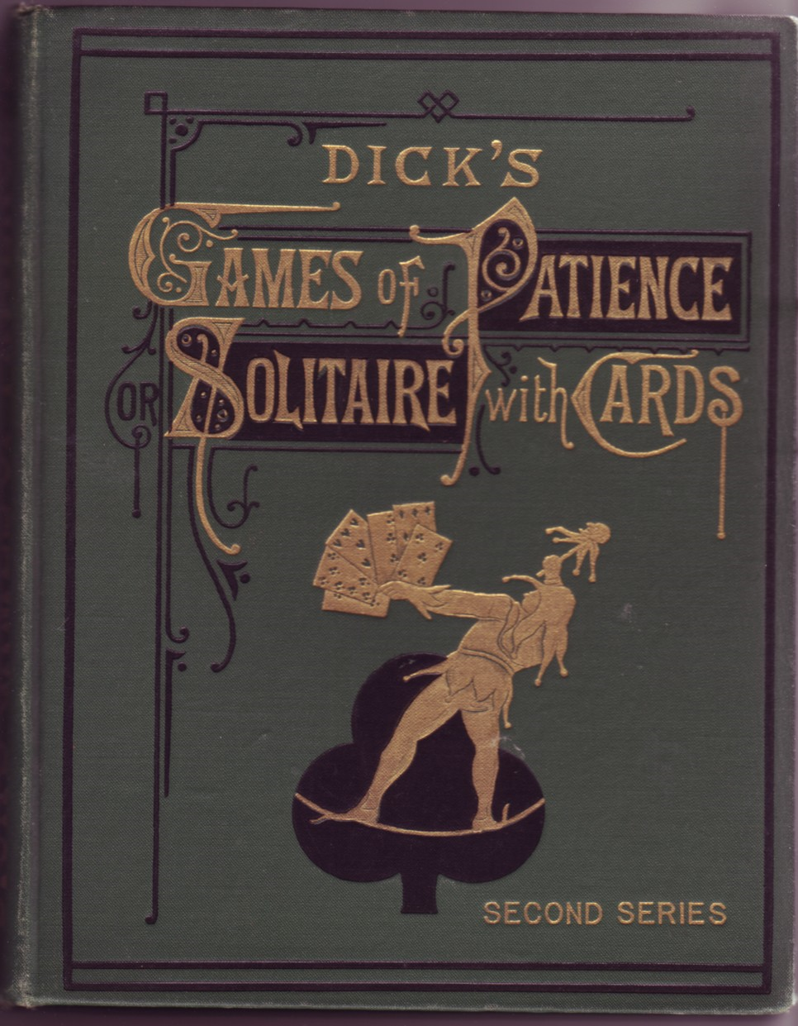
1898:
70 versions of Solitaire

Slide 65
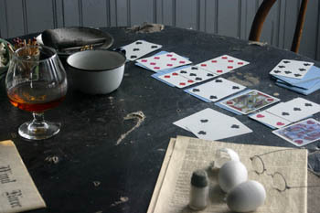
Sorting: Solitaire
“a roundabout method of sorting cards”

Slide 66
Sorting: Solitaire
Real-life Solitaire is a slow ritual

Slide 67
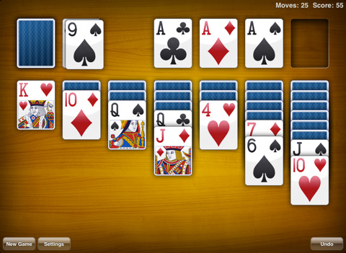
Sorting: Solitaire
Computer Solitaire is fast and focused

Slide 68
Sorting: Solitaire
On a computer just do:
trial and error

Slide 69
Sorting: Solitaire
Without a computer people think longer...

Slide 70
Sorting: Solitaire
Many different versions:
Klondike Solitaire: moves faster and faster
as you progress

Slide 71
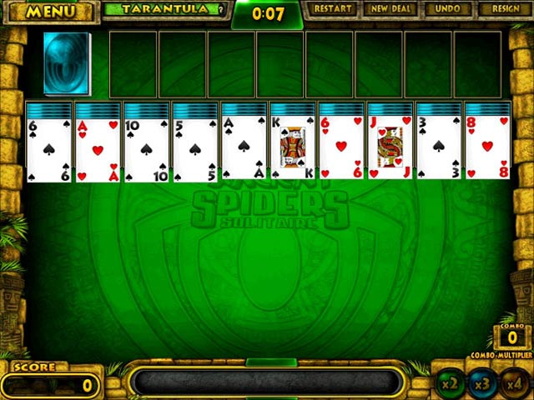
Sorting: Solitaire
Many different versions:
Spider Solitaire: gets progressively
more difficult because the game
allows more options, and thus requires
the player to keep track of more and
more options as you go along.

Slide 72
Sorting: Solitaire
Neither is necessarily better:
Klondike Solitaire is accessible
Spider Solitaire is more complex
In 2005, Microsoft reports that Spider
Solitaire finally passes Klondike as most
played game!

Slide 73
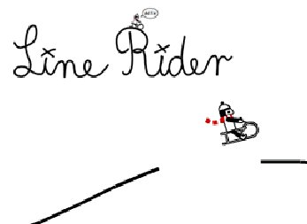
Constructing: Line Rider

Slide 74
Games need a simple shape. But that shape can be a fractal!

Slide 75

Gestalt

Slide 76
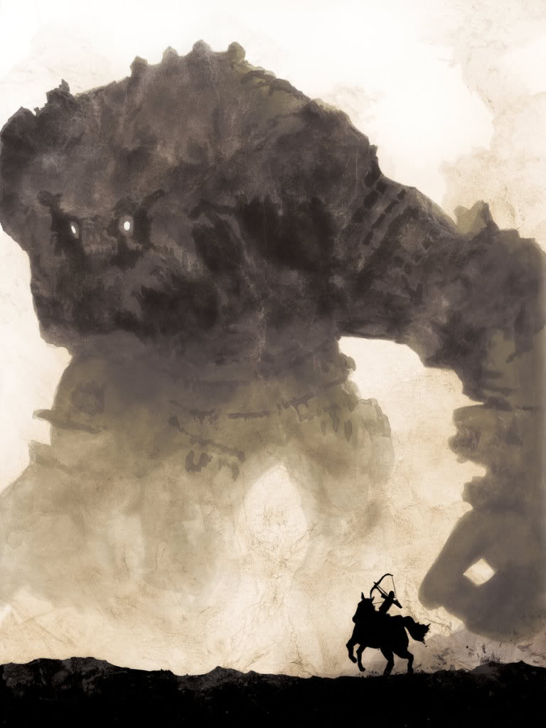

Slide 79
Gestalt of mechanics...
production
defense
offense
*
1
0
50%
+1
2
5
*
1
50%
factories
offense
defense

Slide 80
Feedback and patterns
production
defense
offense
*
1
0
50%
+1
2
5
*
1
50%
factories
offense
defense

Slide 81
Machinations can be used to create less:
+

Slide 82
Machinations can be used to create less:
+

Slide 83
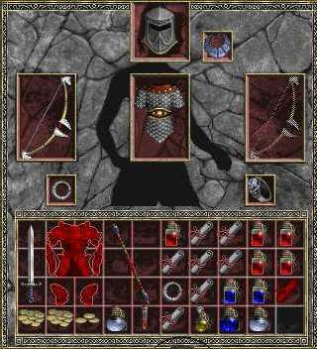

Slide 84
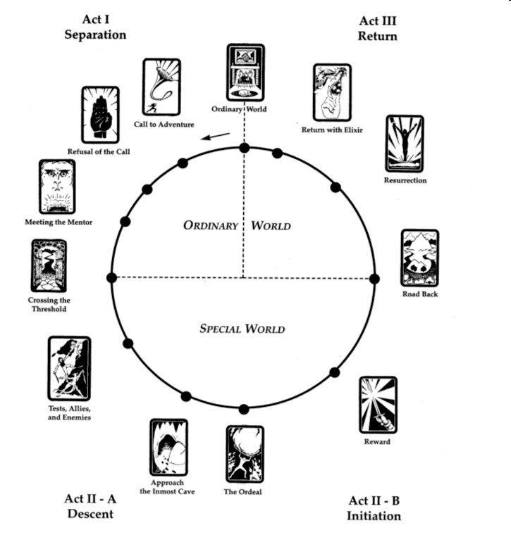
The writer’s journey
Christopher Vogler

Slide 85
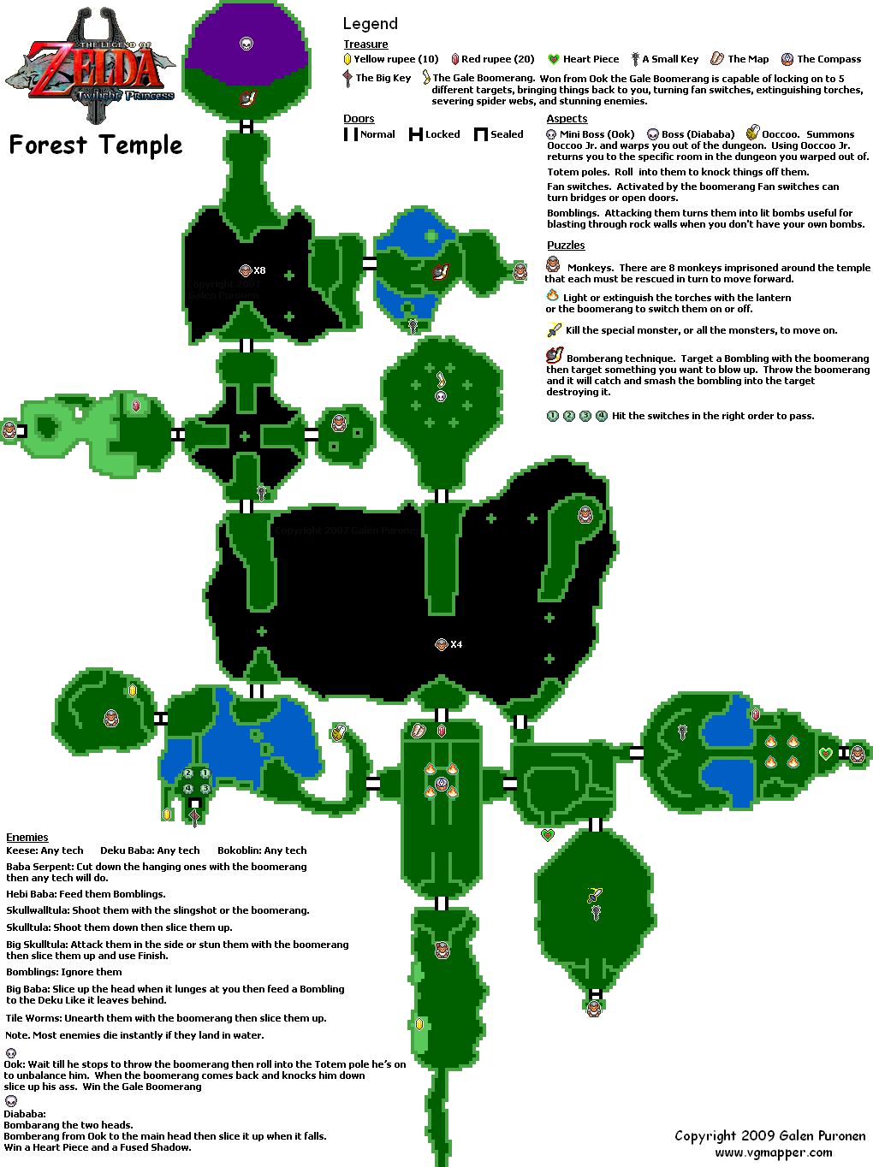
spoke
spoke
spoke
hub
spoke
spoke
hub
spoke
spoke

Slide 86
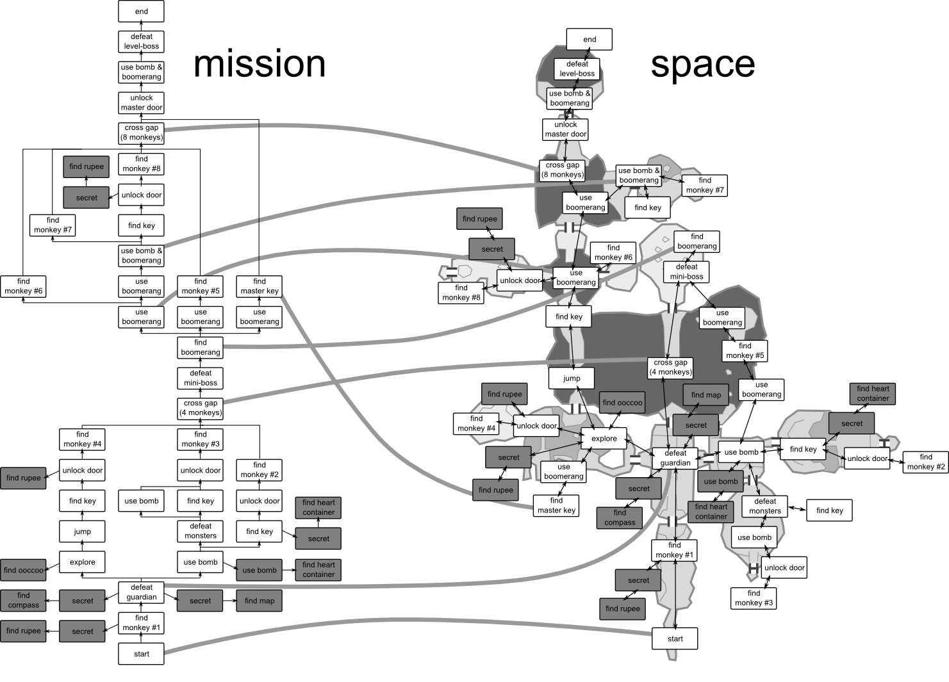
kumite
kata
kihon-kata
kihon
kihon-kata
kihon

Slide 87
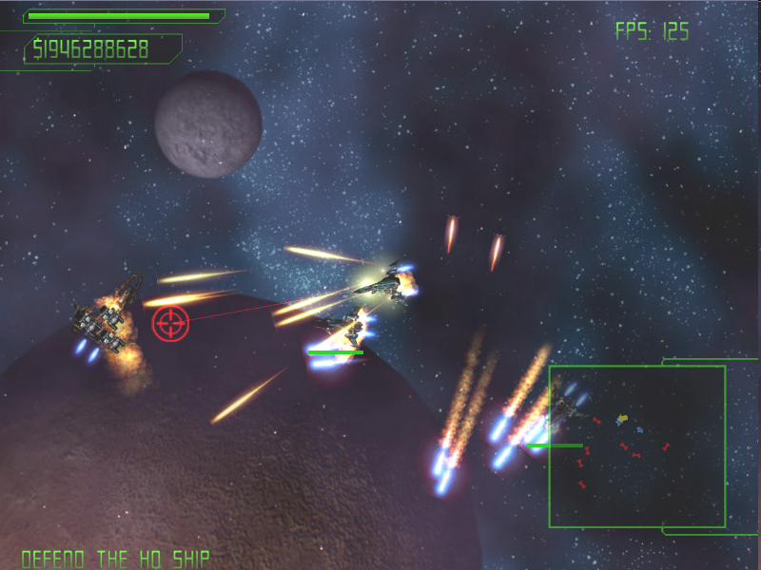
Consistence over realism

Slide 88
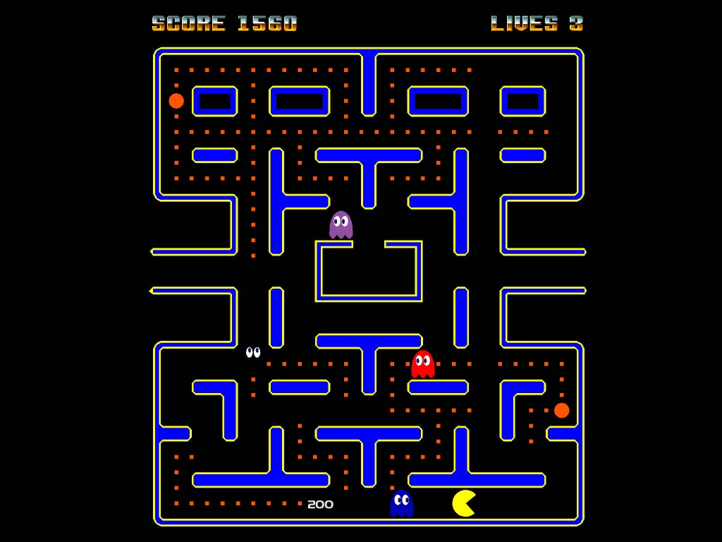

Slide 89
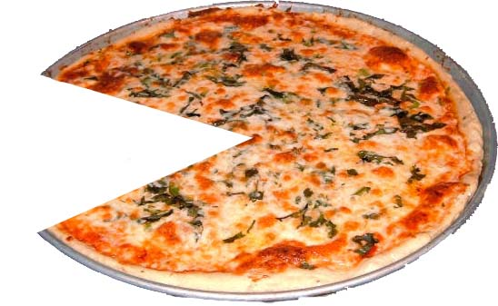
To eat

Slide 90
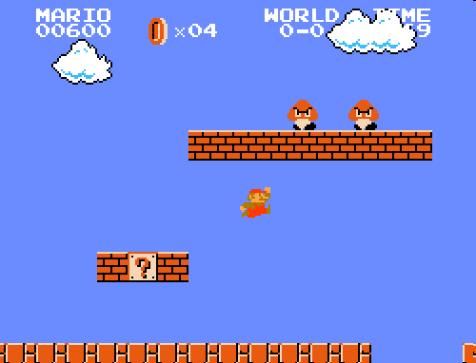

Slide 91
To jump

Slide 92
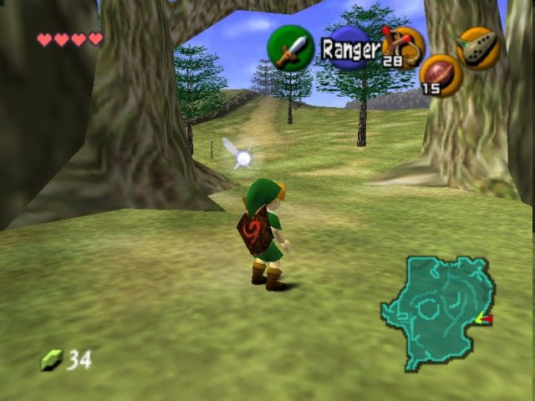

Slide 93
To explore

Slide 94
etc...

Slide 95
Assignment:
Polish a game into perfection!

Slide 96
Reading assignment
Daniel Cook “Building Tight Game Systems of Cause and Effect” http://www.lostgarden.com/2012/07/building-tight-game-systems-of-cause.html
Jesper Juul “In search of lost time” http://www.jesperjuul.net/text/losttime/
Jonasson & Purho “Juice it or lose it” http://www.youtube.com/watch?v=Fy0aCDmgnxg

